Slide 1
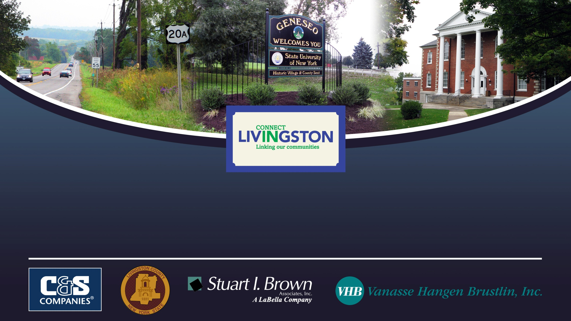
Livingston County Transportation Connectivity Plan
Final Report
December 2013

Slide 2
Agenda
Presentation
Project Overview
Vision
Goals
Strategies
Examples for Each Goal
Geneseo Pilot Plan Representative Projects

Slide 3
Vision to Implementation
Vision
Broad expression of desired end state
Goals
Measurable; guide decision-making
Strategies
Action-oriented; based on needs assessment
Specific actions; developed locally (i.e. Geneseo Pilot Plan)
Projects

Slide 4
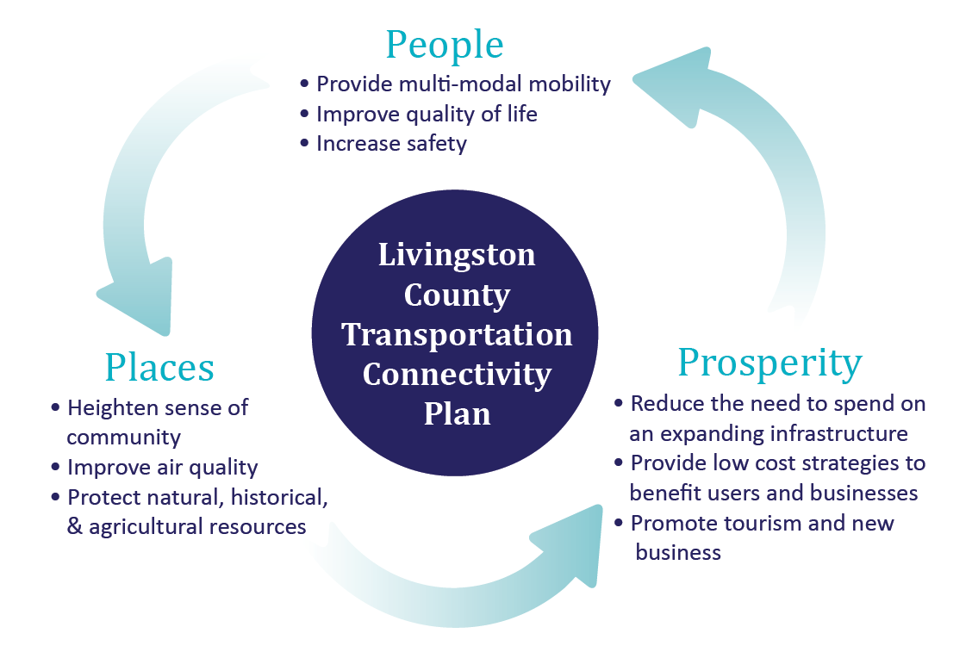
Vision
“Develop a transportation connectivity plan that fosters partnerships and connections for the purpose of supporting and promoting a vital and sustainable Livingston County for existing and future residents and visitors alike.”
Notes:
3Ps: People, Places & Prosperity
Provides Choices
Efficiency
Equity
Improves Livability/Quality of Life
Air quality
Safety
Health benefits
Fosters partnerships/support community
Economic development
Sustainable/protects resources

Slide 5
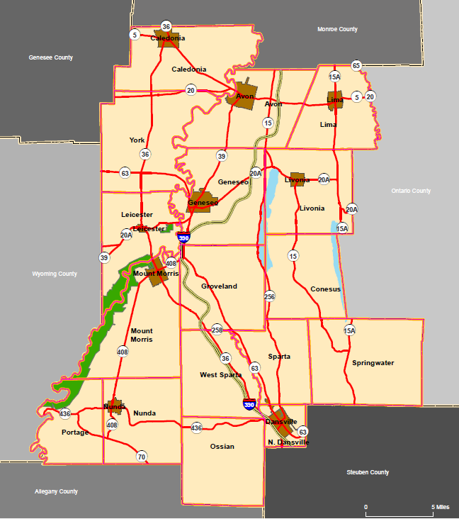
Existing Conditions
Transportation system baseline
Infrastructure
Programs & services
Policies
Detailed review of previous studies
Notes:
Understand characteristics of the county and its municipalities – diversity: rural & village centers, commercial, agricultural, educational, historical, recreational, etc…

Slide 6

Needs Assessment
Project committees
Interviews
Previous studies
Public meetings
Public survey

Slide 7
Goals
Goal #1: Provide a sustainable transportation network that provides facilities for and encourages use by all modes, with particular emphasis on pedestrians and bicycles.
Goal #2: Improve safety for all modes and users of the transportation system through design, innovative technology, and education.
Goal #3: Improve freight transportation infrastructure and access.
Goal #4: Provide comprehensive and innovative public transportation services through LATS and other human service and transportation providers.
Goal #5: Promote efficient, innovative, and sustainable system management, maintenance, and operations.
Goal #6: Preserve, protect, and enhance the County’s quality of life, natural environment, cultural heritage, and community appearance.

Slide 8
Strategy Development
Based on Needs Assessment
Refined with Evaluation Criteria
Cost, modes served, connectivity, etc.
Identify time frame, responsible agency, funding sources
Specific projects identified locally (i.e. Geneseo Pilot Plan)

Slide 9
Strategy Examples
Goal #1:
Provide a sustainable transportation network that provides facilities for and encourages use by all modes, with particular emphasis on pedestrians and bicycles.
Strategy 1b:
Provide pedestrian/bicycle amenities such as bike parking, landscaping, street furniture, etc.

Slide 10
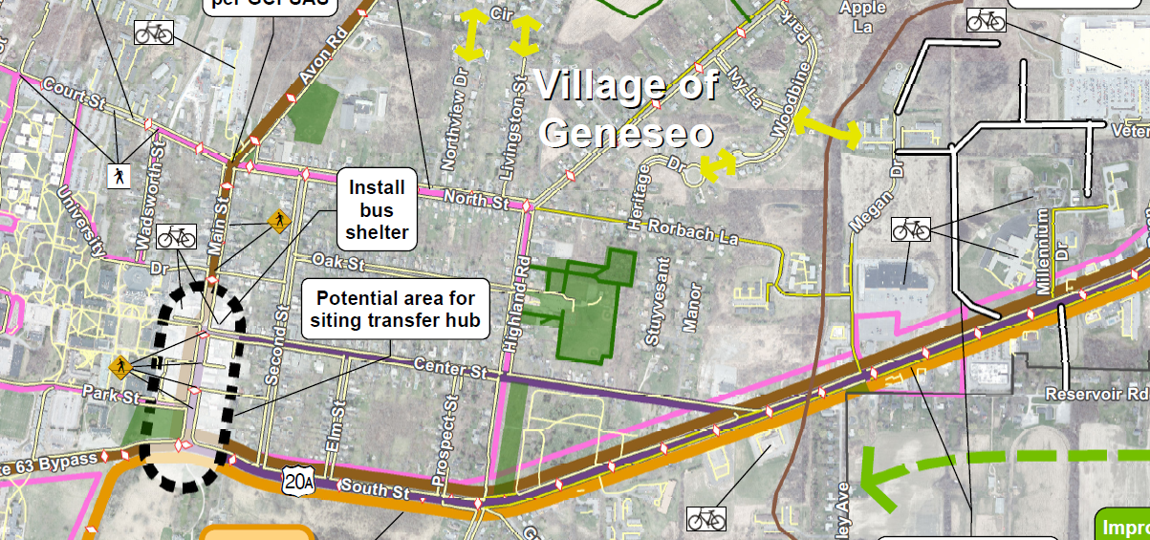
Geneseo Pilot Plan
Notes:
Representative Project:
Install bicycle racks along Main Street at Center Streets, at Key Bank on Bank Street, and at public buildings such as the Livingston County offices on Court Street and at government, medical and other community facilities along Lakeville Road.

Slide 11
Strategy Examples
Goal #2:
Improve safety for all modes and users of the transportation system through design, innovative technology, and education.
Strategy 2d:
Implement intersection, roadway, and corridor safety improvements.

Slide 12
Geneseo Pilot Plan
Representative Project:
Construct intersection, roadway and safety improvements at the Main Street/Court Street/North Street/Avon Road intersection; Replace traffic signals; install bumpouts and lighting.

Slide 13
Strategy Examples
Goal #3:
Improve freight transportation infrastructure and access.
Strategy 3e:
Market/promote/educate the importance of freight transportation.

Slide 14
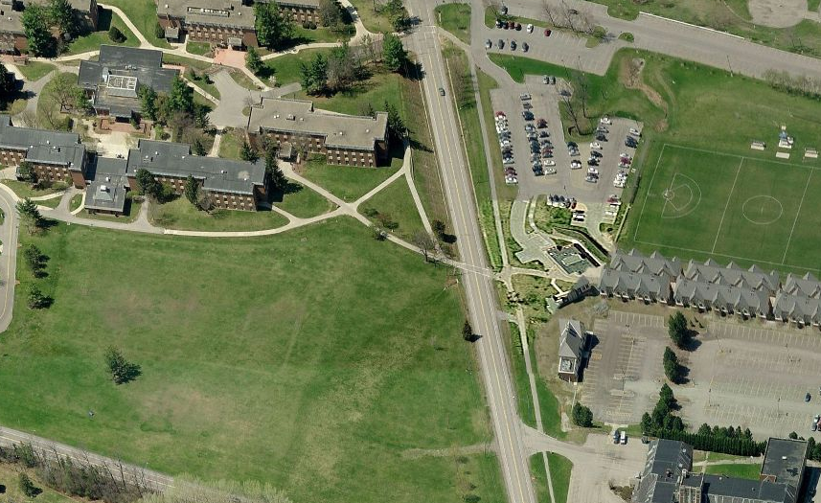
Geneseo Pilot Plan
Representative Project:
Promote safety awareness among SUNY students and others with regard to NYS Route 63 truck traffic.

Slide 15
Strategy Examples
Goal #5:
Promote efficient, innovative, and sustainable system management, maintenance, and operations.
Strategy 5.c:
Develop special event and emergency traffic management plans.

Slide 16
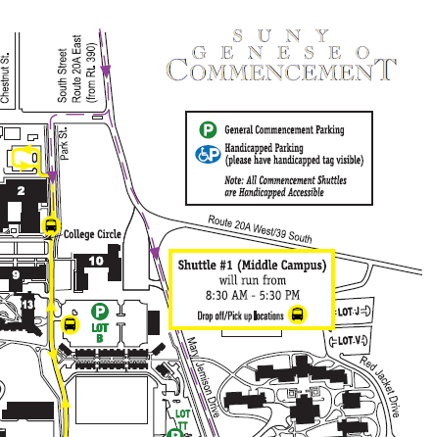

Geneseo Pilot Plan
Representative Project:
Coordinate the development of special event plans for SUNY Geneseo, Historic Warplane Museum, & the Geneseo School District.

Slide 17
Strategy Examples
Goal #6:
Preserve, protect, and enhance the County’s quality of life, natural environment, cultural heritage, and community appearance.
Strategy 6b:
Research, implement, and/or support initiatives that reduce transportation energy consumption.

Slide 18
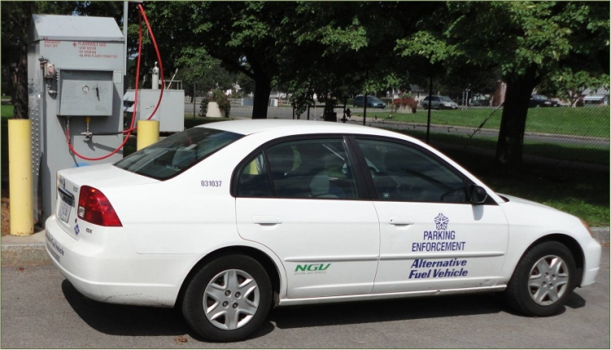
Geneseo Pilot Plan
Representative Project:
Install electric vehicle charging stations in the Village of Geneseo, including SUNY Geneseo and government offices.

Slide 19
Strategy Examples
Goal #4:
Provide comprehensive & innovative public transportation services through LATS and other human service and transportation providers.
Strategy 4c:
Improve frequency and service span.

Slide 20
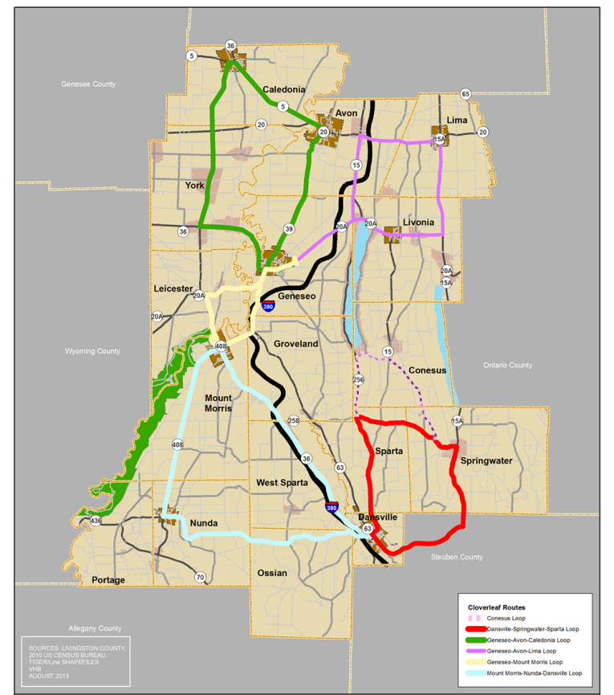
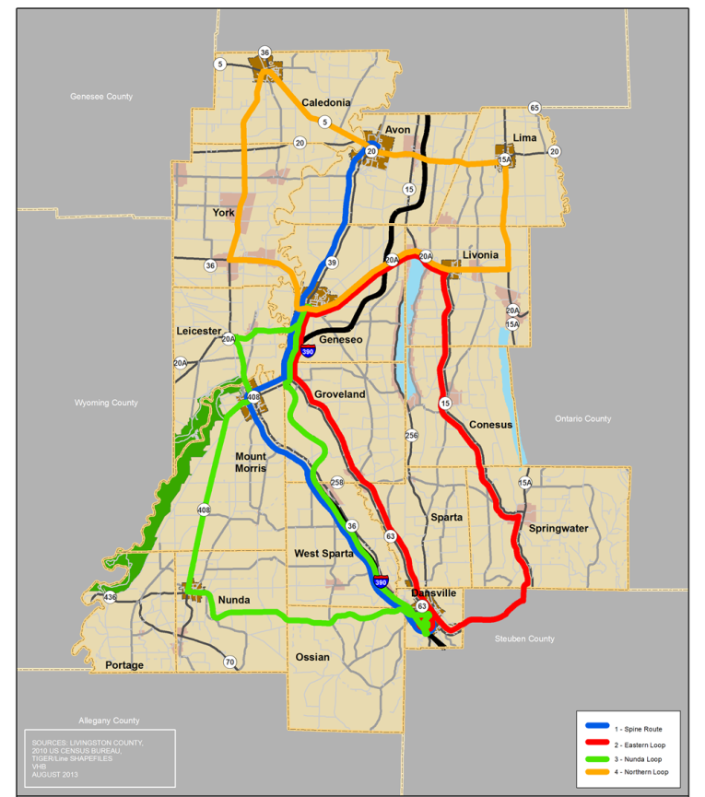
Alternative Transit Route Options
Geneseo Transfer
Cloverleaf

Slide 21
Follow-on Activities
Use this document and its vision as a guideline
Implement strategies at county-wide and municipal level

