Slide 1

Livingston County Transportation Connectivity Plan
Kick-off Meeting
February 15, 2012
Notes:
1

Slide 2
Agenda
Introductions
Study Description & Schedule
Project Roles
Public/Stakeholder Participation Plan
Brainstorm and Develop Study Vision
Next Steps
Notes:
2

Slide 3
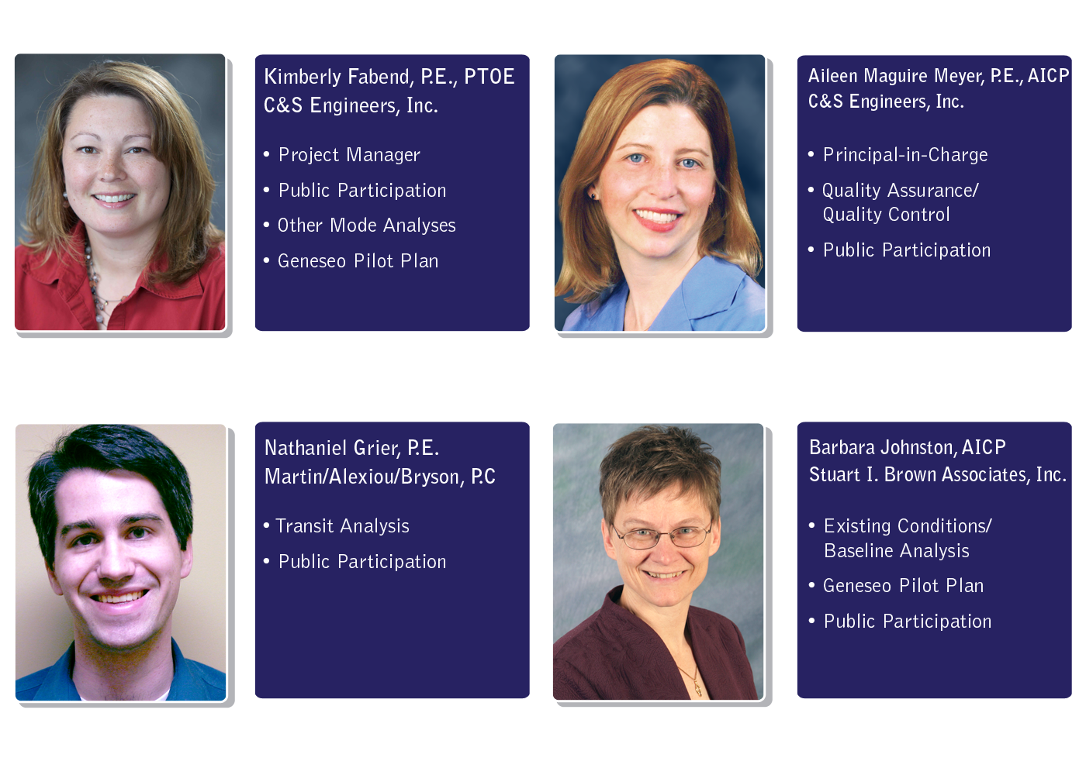
Project Team
Notes:
3

Slide 4
Study Purpose - Connectivity
Provides choices
Efficiency
Equity
Improves Livability/Quality of Life
Air quality
Safety
Health benefits
Notes:
When we put together the application for the project, our group established the following overall objective:
Develop a plan that “fosters partnerships and connections between government, private, nonprofit and educational agencies for the purpose of supporting and promoting a vital and sustainable Livingston County for existing and future residents and visitors alike.”
Additional purposes:
Improves access to goods and services
Supports community development, downtown revitalization, and economic vitality
Links our historical, cultural and recreational assets to support the County’s valuable position as an attractive tourism destination in the Finger Lakes region.
Protects our natural and agricultural resources
4

Slide 5
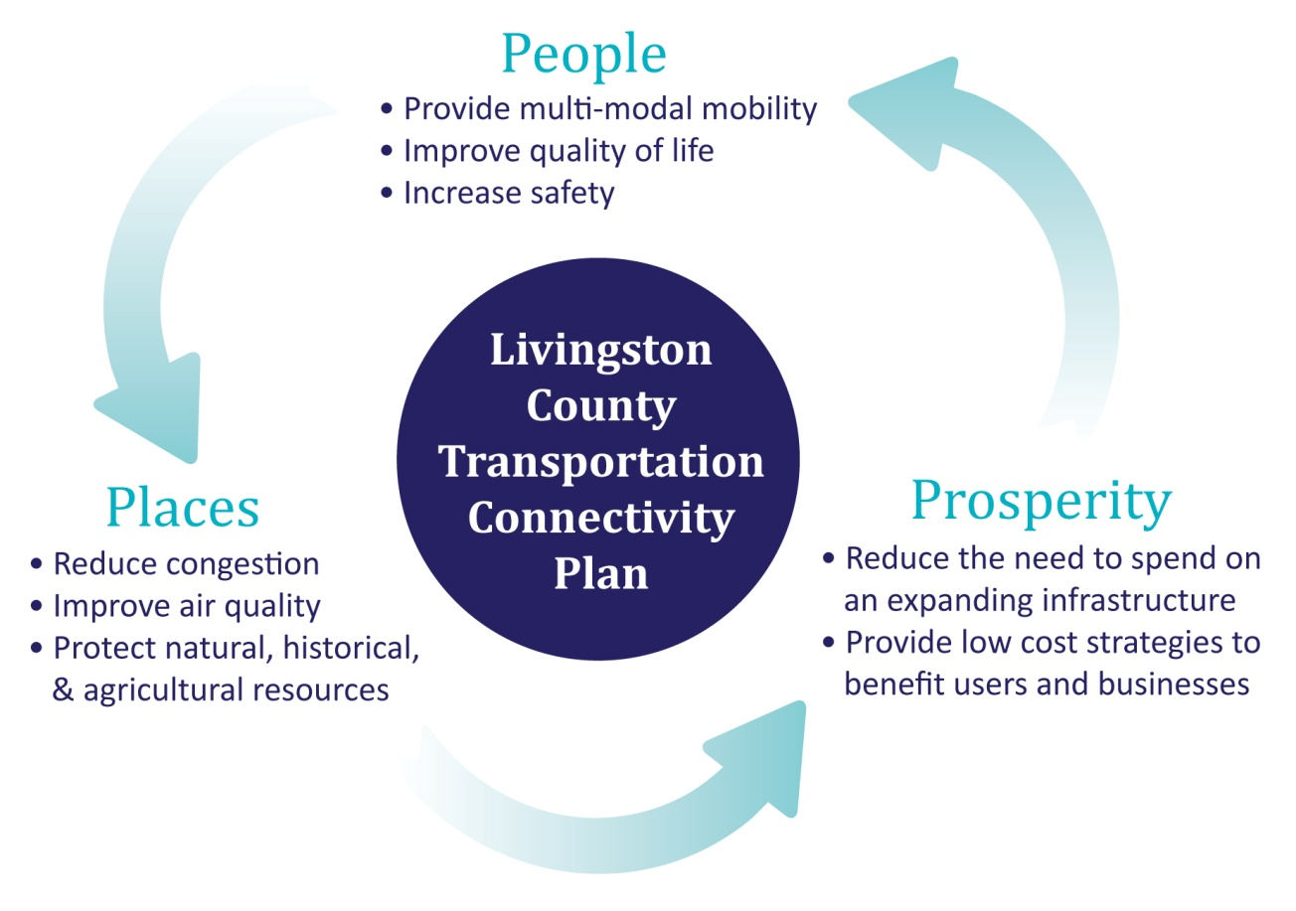
Sustainable Transportation System
Notes:
See the Livingston County graphic that we’ve been using to promote the project. Please feel free to revise however you feel appropriate. I’ll send via email.
Congestion not an issue for our county.
5

Slide 6
Study Description - Assessment
Assessment
Existing Conditions
Needs/ Gap Analysis
Integration of Modes
Highway/Bridge
Pedestrian/Bicycle
Freight/Rail
Aviation
Notes:
Existing Conditions
Compile and assess inventory information
Identify relevant findings/recommendations in existing plans and studies
Needs Assessment – What is being served today? Future anticipated needs
On-board survey
Stakeholder interviews
Existing conditions analysis
Transit - GIS-based demand estimate and route analysis
Public Transit is missing from the slide.
6

Slide 7
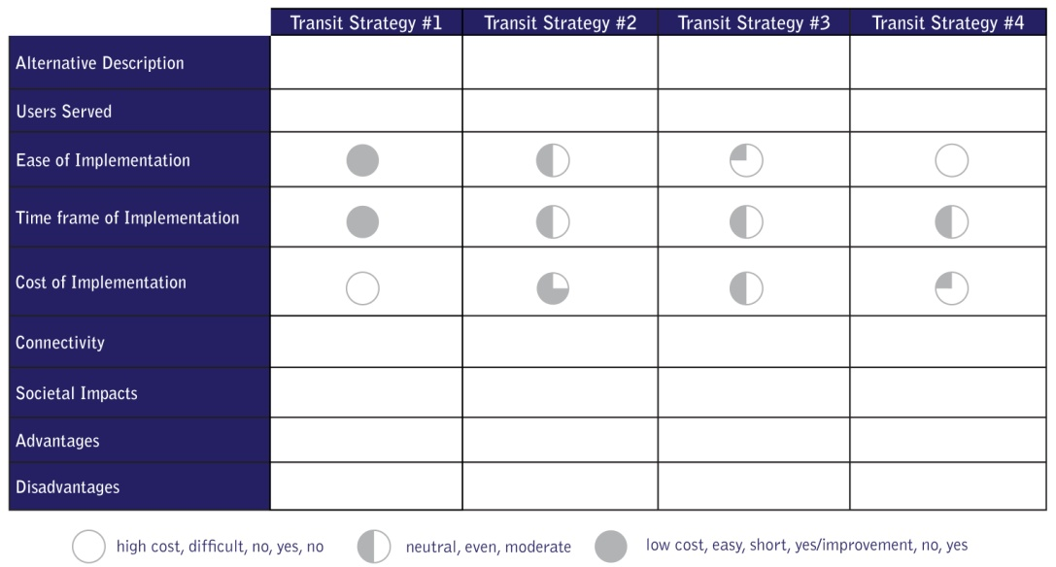
Study Description - Alternatives
Improvements to bridge gaps
Multi-modal approach
Strategies
Capital Projects
Services/Programs
Policy/Planning
Evaluation
Notes:
Alternatives development – identify improvements that will bridge gaps
Multi-modal approach – one solution will not meet all needs
- in some cases the best connection will be by auto or transit in other cases it may be a combination of transit or bike/ped connections
Strategies:
Capital Projects
• Bicycle and pedestrian infrastructure
• Road and bridge improvements
Trails
Projects that support walkable communities
Rail and Airport (GTC Regional Goods Movement Strategy)
Services/Programs
• Public transit
• Private transit (campus services)
• Paratransit
• Transportation Demand Management (TDM)
• Marketing and education
Share-ride and volunteer programs
Services for special needs and aging population
Policy/Planning
• Zoning modifications to better integrate the land use-transportation connection
• Complete streets guidelines
Healthy LIVINGston (Healthy communities programs)
Public safety
7

Slide 8
Study Description - Deliverables
Action Plan
Vision statement
Measurable goals
Strategies to meet goals
Geneseo Pilot Plan
Example of implementation
Final Report
Notes:
Pilot Plan
The Town and Village of Geneseo serve as the county seat and is an excellent example of a municipality with different transportation characteristics and needs: village and rural areas, shopping/tourist attractions, historical landmarks, and the State University of New York at Geneseo. A pilot action plan for Geneseo will serve as a template or example plan to be developed and implemented in the county’s other municipalities.
Please add identification of funding resources and monitoring and evaluation framework for measuring progress
8

Slide 9
Anticipated Schedule
(Show revised schedule starting in mid-Feb)
Notes:
9

Slide 10
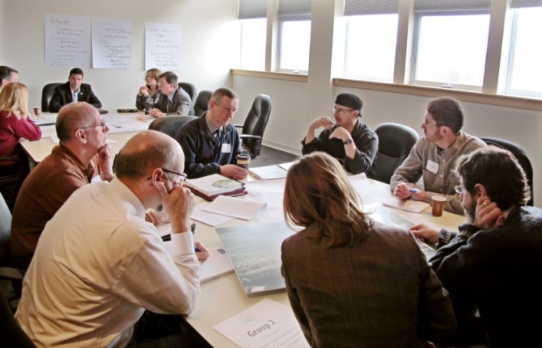
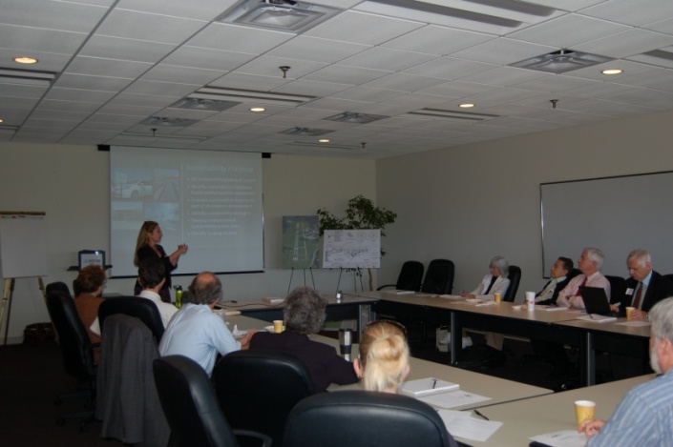
Public/Stakeholder Participation
Roles
Project steering committee
Stakeholders
Public information meetings
Inventory and needs
Geneseo Pilot Plan
Action plan
Marketing and promotion
Notes:
An inclusive community communications and promotion plan is integral to any planning
project, helping to set the stage for successful implementation of final plan recommendations.
The group that is meeting is the Project Stakeholder Advisory Committee. The Steering Committee will be the smaller group on the following page. I would expect that the Project Advisory Committee will probably meet 3 times total? 1) Kick-off; 2) Confirmation on the Inventory and Assessment; and 3) Action Plan Development. The Steering Committee will meet more frequently as needed.
10

Slide 11
Project Steering Committee
Livingston County (Planning, Highway, Tourism)
NYSDOT
Genesee Trans Council
RGRTA
Department of Health
Department of Social Services
Genesee Valley Conservancy
At-Large Member
Notes:
Steering Committee includes representatives from these organizations
Livingston County (Planning, Highway, DOH, DSS, OFA)
Genesee Transportation Council
RGRTA
County Tourism Agency
NYSDOT
Genesee Valley Conservancy
At-Large Member (Also a liaison for the Geneseo Committee)
Role of Steering Committee
Project Steering Committee
Identify key stakeholders
Provide resources for data/information
Provide input on technical issues
Identify existing/future needs
Brainstorm alternatives
Advise on potential impacts
Review draft documents and public meeting presentation material
11

Slide 12
Stakeholders
Employers
SUNY Geneseo
Noyes Hospital
Livingston County
School Districts
Kraft
Chamber of Commerce
Others?
Transportation Providers
LATS/RGRTA
Dept. of Social Services
ARC
Taxi Companies
Others?
Consumers/Advocacy Organizations
Seniors Students
Bicyclists/Pedestrians
Persons with Disabilities
YMCA
Cornell Cooperative Extension
Others?
Highway, Rail, Aviation
County, Town, Village Highway Superintendents
Railroad Companies
Dansville Airport
Traffic Safety Board
Others?
County Board of Supervisors
Public/Human Services Committees
County Planning Board
Ag & Farmland Protection Board
Environmental Management Council
Human Service Providers
Catholic Charities
Dept. of Social Services
Health/Mental Health Dept.
Office for the Aging
Veterans Services
Others?
Notes:
Role of Stakeholders – missing any?
The group meeting is the larger Stakeholder Advisory Committee, but not all of these folks will be represented on the Committee.
Add Tourism next to Chamber of Commerce
Add Genesee Community College and Seneca Foods to Employers
Would also suggest adding small businesses to capture downtown revitalization, but not sure how to best capture these folks
Public Safety needs to be added, but not sure where – Maybe under highway rail and aviation?
Under Transportation Providers, DSS Transportation Broker should be added. Also OFA and Red Cross
Human Service Providers: Should read Department of Health, Department of Community Services & Mental Health
Box with County Board of Supervisors needs a title. Maybe Government? Add Traffic Safety Board here. Also add Town and Village Officials
We don’t have a YMCA
Need to add environmental groups – trail people, snowmobile groups, Letchworth, agriculture (alternatively ag could fall under business), DEC Region 8, historians
Workforce Development needs to be added to Human Service Providers
Add Genesee Valley Health Partnership to Consumer/Advocacy
Stakeholders
Much of the data needed to develop the plan will come from key stakeholders
–those that currently provide and use the available services.
those who represent traditionally under served populations, including persons with disabilities, ethnic, minority, and low income groups.
The Project Team will conduct interviews with representatives from each stakeholder group to obtain their knowledge and perceptions of the existing system as well as their thoughts on where the system could and should be in the future.
12

Slide 13
Stakeholder Interviews
(List major categories of questions)
Notes:
Have some questions ready to start discussion
Guide discussion
13

Slide 14

Marketing & Promotion Plan
Notes:
# of meetings
Make suggestions – guide discussion
14

Slide 15
Vision Statement
Key messages
Defines the future you want to create
A vision not a prophecy
Energizes team members to support goals
The purpose is to push boundaries and see the plan moving beyond current realities
A good vision statement:
Sets a standard of excellence
Clarifies direction and purpose
Inspires enthusiasm and commitment
Bridges the present and future
Is clear and easy to understand
Is ambitious
(not limited by current circumstances)
Notes:
Keep them short, simple, to the point
Sears—To be the preferred and most trusted resource for the products and services that enhance home and family life.
Nike—To be the number one athletic company in the world
Kraft Foods—Helping people around the world eat and live better
General Motors—GM’s vision is to be the world leader in transportation products and related services. We will earn our customers’ enthusiasm through continuous improvement driven by the integrity, teamwork, and innovation of GM people.
Anheuser-Busch—Be the world's beer company. Through all of our products, services and relationships, we will add to life's enjoyment.
Pasadena: “To provide a quality travel experience for users of all modes while elevating the importance of safety, livability, and sustainability.”
Other examples – guide discussion
15

Slide 16
Vision Statement
Brainstorm – gather input
Draft statement distributed for review
Notes:
16

Slide 17
Communication Protocols
Single-point of contact
Angela Ellis, Planning Director
Livingston County Planning Department
6 Court Street, Room 305
Geneseo, NY 14454
(585) 243-7550
AEllis@co.livingston.ny.us
Notes:
17

Slide 18
Next Steps
Review Existing Documents
Interview Stakeholders
Inventory Existing Services & Resources
Existing Baseline Assessment Memorandum
Steering Committee Meeting #2
Notes:
Stakeholder Advisory Committee
18

